Slide 1
Structure Of Personality By Sigmund Freud
Muhammad Anas
Owais Ali Khan
Uzair Shehzad
Hussain Malik
Hamza Iqbal

Slide 2
Agenda
Introduction
Level Of Awareness
Id
Ego
Super Ego

Slide 3
Introduction

Slide 4

Personality Theory
“No two persons are born exactly alike; but each differs
from the other in natural endowments, one being suited
for one occupation and the other for another…”
Plato, The Republic (360 BCE)

Slide 5
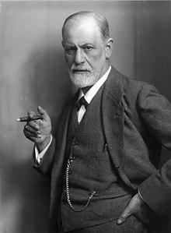
Psychoanalytic Theory originated by Sigmund Freud, M.D.
Freud was a Viennese physician who thought his patients’ problems were more emotional than physical
Freud began his work by using hypnosis and eventually switched to psychoanalysis
Freud had many followers: Jung and Adler, to name a few
Freud used cocaine and tobacco and died from oral cancer
More than 100 years later, his work is still influential and very controversial

Slide 6
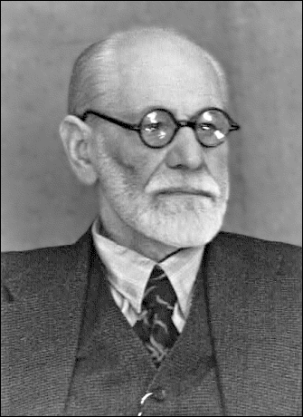
Psychoanalytic Theory
Freud asserts we are motivated by psychosexual forces
Childhood experiences and unconscious motivations determine our adult thoughts and behaviors.
We are captives of our biological and environmental forces.
The 3 personalities in a person are the id, ego, and superego.
Id - the deep unknown force inside us wanting pleasure.
Superego – the parental voice and values that govern thought.
Ego – the mediating manager.

Slide 7
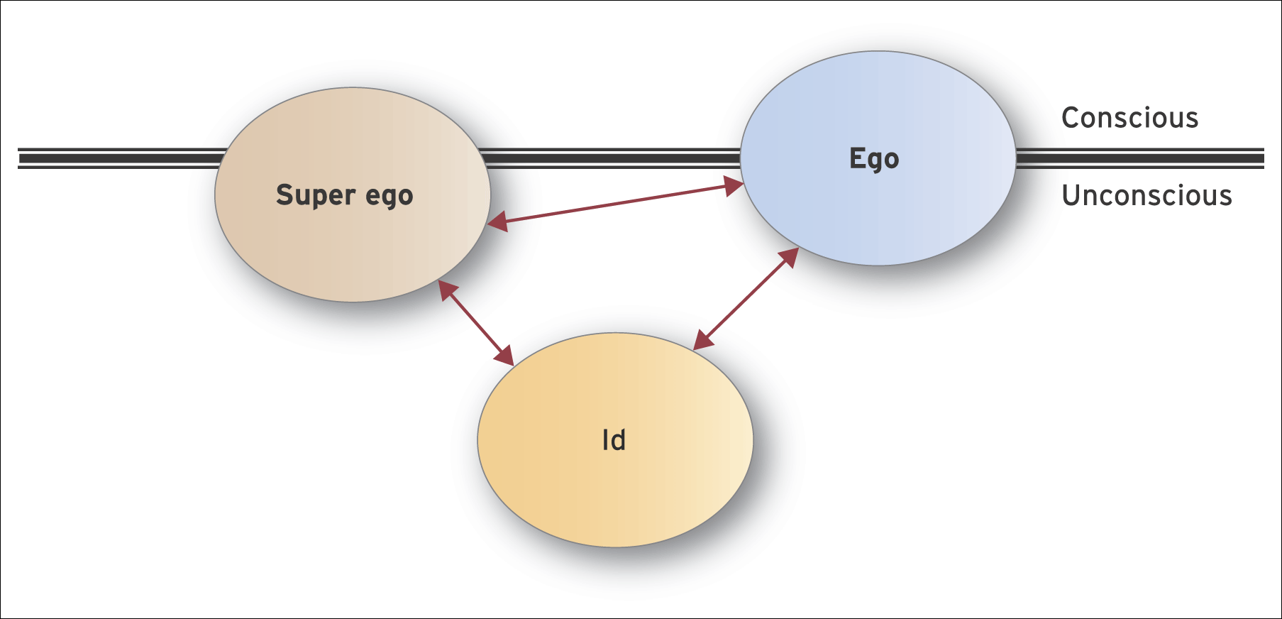
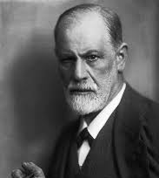
Freud’s Structure of Human Personality

Slide 8
Psychoanalytic Theory
Carl Jung – Our personality is decided by the past and what we hope to become. He gave a greater role to the ego.
Eric Erikson – There are 8 stages of psycho-social forces that motivate us and determine if we grow or not.
Trust vs. Mistrust
Autonomy vs. Shame
Initiative vs. Guilt
Industry vs. Inferiority
5. Identity vs. role confusion
6. Intimacy vs. Isolation
7.Generativity vs.Stagnation
8. Integrity vs. Despair
These stages, if satisfied, move us to the next stage or we will stagnate and live in misery if we don’t satisfy them.

Slide 9
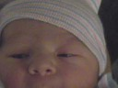
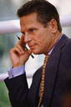
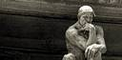
Raw, uninhibited instinctual energy
Source of impulses and mental energy
Also drives for basic survival needs, and sex, aggression and self-destruction
Id
Planning, thinking and organizing
Mediator between child and world
Reality principle and secondary processes
🡪 social factors
Ego
Conscience (internalized parental attitudes etc).
Acts in opposition to the Id.
Also regulation of the ego…..
Superego

Slide 10
Main Concepts

Slide 11
Levels Of Awareness
Consciousness
Preconsciousness
Unconsciousness

Slide 12
Levels Of Awareness
The conscious mind involves thoughts that someone is aware of at any given moment.
The preconscious mind involves things that can be brought into consciousness at any time.
The unconscious mind includes the thoughts and feelings that exist outside of one's conscious awareness.

Slide 13
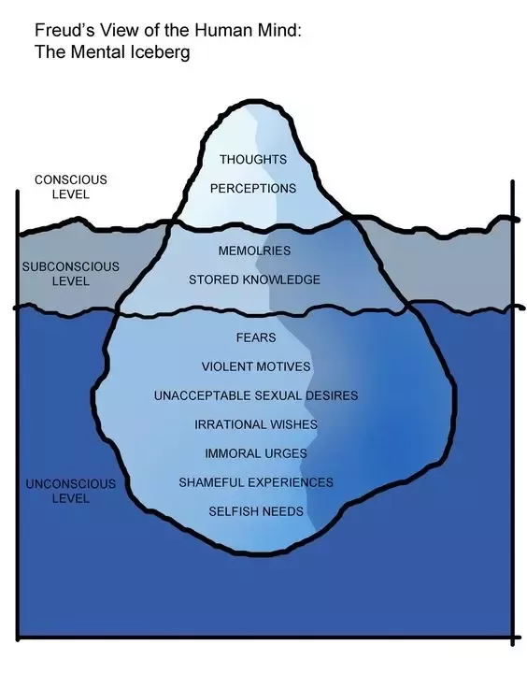
This is the aspect of our mental processing that we can think and talk about rationally.
Consists of anything that could potentially be brought into the conscious mind.
Contains contents that are unacceptable or unpleasant

Slide 14

Consciousness
We are conscious of both the external world and our internal selves
But where does Consciousness come from?
Scientist theologians and philosophers have been trying to get to the bottom of this question for centuries without reaching any consensus.
Recent Theory: consciousness is the brains imperfect picture of its own activity.
Based on sensory inputs it builds models, everything we know is based on these models.

Slide 15
Examples
For instance, one model built deep into the visual system chords white light as brightness without color in reality white light includes wavelength that correspond to all the different colors we can see. Our concept of white light is wrong and oversimplified but good enough for us to function.
If it didn't have the model keeping track of the body's size shape and how it is moving at any moment, we would quickly injure ourselves.

Slide 16
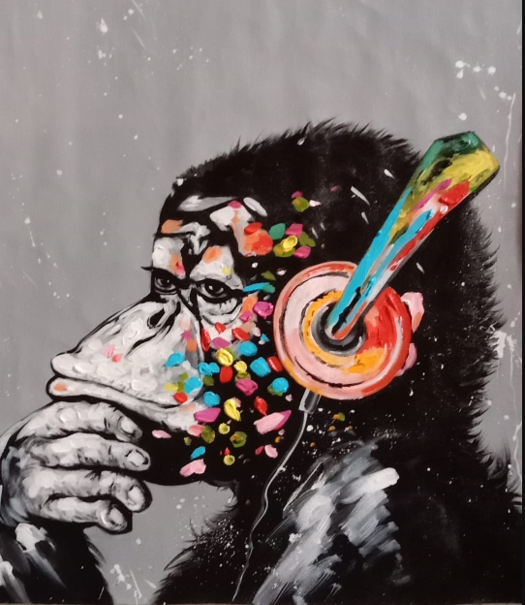
Preconsciousness
The preconscious can also refer to the information available for cognitive processing but that currently lies outside conscious awareness.
Freud's View
The term preconscious was used to denote the screen between the unconscious and conscious.
If consciousness is the sum of everything of which we are aware, pre-consciousness is the reservoir of everything we can remember, all that is accessible to voluntary recall.

Slide 17

Unconsciousness
The mental processes of which individuals make themselves unaware.
In psychoanalytic terms, the unconscious does not include all that is not conscious.
Methods Capable to "tap" and "interpret" Unconscious Mind
Meditation
Dream analysis
And Verbal slips, etc.

Slide 18
Freud's View
Freud noticed that also his patient's dreams expressed important feelings they were unaware of. After these observations, he concluded that psychological disturbances are largely caused by personal conflicts existing at the unconscious level.

Slide 19
ID

Slide 20
ID
The id is the only component of personality that is present from birth.
This aspect of personality is entirely unconscious and includes instinctive and primitive behaviors.
The id is very important early in life because it ensures that an infant's needs are met. Young infants are ruled entirely by the ID.
Characteristics Of ID
The id exists in your unconscious, or outside of your awareness. Since the id is not part of your awareness, the desires of the id are not manipulated by experience or thought. The other personality components develop with age and experience, but the id never matures and continues to be driven by desire alone. The id does not think but only wants or acts.
Unorganized, demanding and insistent, illogical, lacks morals, instinctual, selfish, unconscious, etc.

Slide 21

Principle
The id is driven by what is called the pleasure principle, the idea that your needs should be met immediately. When you are hungry, the pleasure principle directs you to eat. When you are thirsty, it motivates you to drink. Tension results when you do not receive instant gratification of all your needs or wants. The id cannot tolerate this tension and puts more pressure on you to satisfy your desire and relieve the tension. This is when other components of your personality come into play.

Slide 22
Real Life Example
If a person is cold, the id demands them to find warmth. Imagine trying to convince a baby to wait until lunchtime to eat their meal. The id requires immediate satisfaction, and because the other components of personality are not yet present, the infant will cry until these needs are fulfilled. However, immediately fulfilling these needs is not always realistic or even possible. If we were ruled entirely by the pleasure principle, we might find ourselves grabbing the things that we want out of other people's hands to satisfy our cravings.

Slide 23
EGO

Slide 24
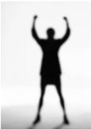
EGO
The ego is 'that part of the id which has been modified by the direct influence of the external world.
It is the decision-making component of personality.
The ego operates according to the reality principle, working out realistic ways of satisfying the id’s demands
The ego considers social realities and norms, etiquette and rules in deciding how to behave.

Slide 25
Why learn ego?
Understanding our ego states helps us to understand:
Who am I?
Why do I act the way I do?
How did I get this way?
It is a method of analyzing a person's thoughts, feelings and behaviors based on the phenomena of ego states.

Slide 26
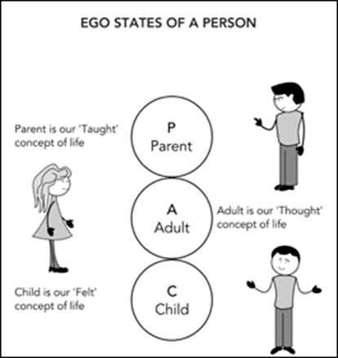
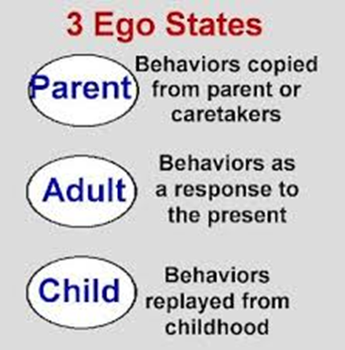
There are three ego states:

Slide 27
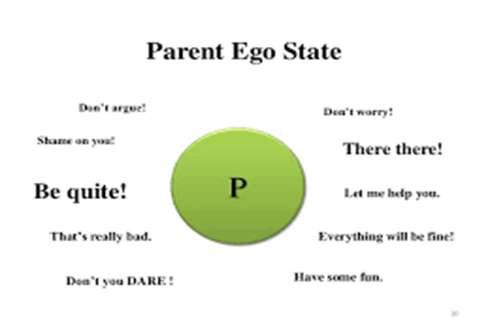
Parent Ego State
When people act, think, or feel as their parent/caregivers once did, they are in the Parent ego state.
For example:
If you have seen your father smoking cigarettes then after certain age you also start smoking, you are now in your Parent ego state.

Slide 28
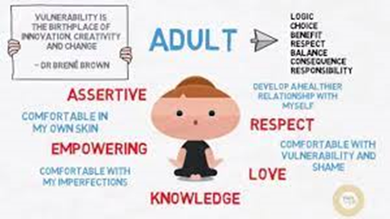
Adult Ego State
When a person is acting based on facts, rather than based on parental tradition or childhood feelings, they are in the Adult ego state.
For example:
When choosing career, a person may look at different opportunities and education and decide according to the need (here and now decision) rather than go with the career chosen by his parents (tradition).

Slide 29
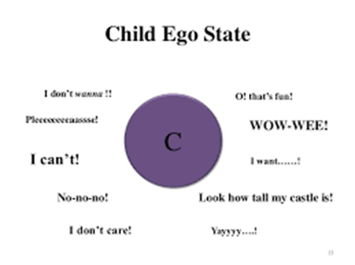
Child Ego State
Contains all natural feelings, needs, impulses, and potentialities of an infant.
It also contains creative, manipulative, intuitive capacities as well as feelings and behaviors learnt during childhood like
Compliance
Procrastination
Anger

Slide 30
How Child Ego Is Triggered?
When a cue in the present environment reminds our body or mind of the past traumatic event, this creates the perfect circumstance for an ego state (also known as part of self) to activate.
For example, a person experiences a body sensation of heat which then reminds them of a traumatic event in which this person was burned as a child. The ego state of ‘rage’, which belongs to the original traumatic incident, becomes activated in the present, causing the ‘rage state’, even though the rage does not fit the present circumstance.

Slide 31
SUPER EGO

Slide 32
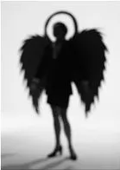
SUPER EGO
In Sigmund Freud's psychoanalytic theory, the superego is the third and most recent of the three agencies that make up a person's personality.
The superego's judgments, restrictions, and restraints serve as one's conscience, while its lofty goals and ambitions serve as one's idealized self-perception, or "ego ideal."
The superego grows in reaction to parental criticism and approval during the first five years of life.
When the superego's ideals are broken, one experiences remorse, worry, and a desire to make amends.

Slide 33

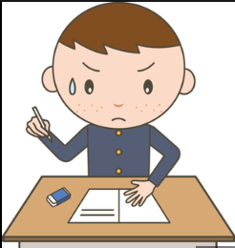
Real Life Example
Despite studying, I was unable to recall the response to exam question 3. Anas was the brightest student in the class, and if I had turned my head just a little bit, I could have read his responses. I was on the verge of cheating when Mr. Invigilator turned around, but I was restrained by my morality because I knew it was wrong. Instead, I guessed the answer and then turned in the paper.

Slide 34
What Happens If A Person's Superego Is Strong
Those who go through this may frequently feel stuck in life.
They might feel alone, struggle with despair, damage themselves, or have violent fantasies.
for example:
Some people who deal with a severe superego may also be more prone to use drugs, alcohol, or other intoxicants, or to act violently or engage in sex, to shut down the accusatory voice inside.

Slide 35
Breaking through a strong Superego is possible?
It requires a lot of effort, but it is possible to transform from a critical to a supportive superego.
The harsh superego is skilled at influencing us in a variety of unconscious ways, so doing this work alone may be extremely challenging. Any form of long-lasting change necessitates awareness and work carried out in a supportive therapeutic environment.

Slide 36
1. Practice at Home
Doing 5–10 minutes of meditation each day. Keep your attention on your breathing while keeping an eye out for any emergencies of the harsh superego.
Awareness is the main source of transformation. Your ability to alter the harsh superego increases as you become more conscious of it. You can use several methods at home that are frequently beneficial.

Slide 37
2. Psychotherapy: A Healing Relationship
A psychotherapist or psychoanalyst can help identify the various ways the harsh superego can negatively affect a person by listening for its various forms.
The therapist's attitude toward this investigation, however, is much more therapeutic than teaching. A caring and empathic therapist can be internalized over time, just like a patient and loving father, taking the place of the critical superego.

Slide 38

Where does all of this apply in real life?
Therapy techniques which use the idea of the unconscious mind to treat patients. The current habits and behaviors of patients might be influenced by what happened with them in childhood Those memories are stored in their unconscious mind The patients are allowed to talk freely about their innate desires, dreams and at random without the constraints of their conscious mind

Slide 39

The very early life of patients, and their relationship with their primary caregivers is also studied Adult problems are traced back to the childhood Repressed painful memories emerge It is discovered that which of the current behaviors, thought patterns and insecurities have their roots in the unconscious mind Once those roots emerge, the current problems are treated accordingly

Slide 40
Thank you

